Slide 1



chapter 4
paradigms

Slide 2
why study paradigms
Concerns
  how can an interactive system be developed to ensure its usability?
  how can the usability of an interactive system be demonstrated or measured?
History of interactive system design provides paradigms for usable designs

Slide 3
What are Paradigms
paradigm is a distinct set of concepts or thought patterns, including theories, research methods, postulates, and standards for what constitutes legitimate contributions to a field.
Predominant theoretical frameworks or scientific world views
  e.g., Aristotelian, Newtonian, Einsteinian (relativistic) paradigms in physics
Understanding HCI history is largely about understanding a series of paradigm shifts
  Not all listed here are necessarily “paradigm” shifts, but are at least candidates
  History will judge which are true shifts

Slide 4
Paradigms of interaction
New computing technologies arrive, creating a new perception of the
human—computer relationship.
We can trace some of these shifts in the history of interactive technologies.

Slide 5

The initial paradigm
Batch processing
Impersonal computing

Slide 6
Example Paradigm Shifts
Batch processing
Time-sharing
Interactive computing

Slide 7
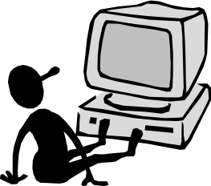
Example Paradigm Shifts
Batch processing
Timesharing
Networking
@#$% !
???
Community computing

Slide 8
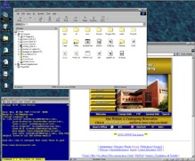
Example Paradigm Shifts
Batch processing
Timesharing
Networking
Graphical displays
Move this file here,
and copy this to there.
C…P… filename
dot star… or was
it R…M?
% foo.bar
ABORT
dumby!!!
Direct manipulation

Slide 9
Example Paradigm Shifts
Batch processing
Timesharing
Networking
Graphical display
Microprocessor
Personal computing

Slide 10
Example Paradigm Shifts
Batch processing
Timesharing
Networking
Graphical display
Microprocessor
WWW
Global information

Slide 11

Example Paradigm Shifts
Batch processing
Timesharing
Networking
Graphical display
Microprocessor
WWW
Ubiquitous Computing
A symbiosis of physical and electronic worlds in service of everyday activities.

Slide 12
Time-sharing
1940s and 1950s – explosive technological growth
1960s – need to channel the power
J.C.R. Licklider at ARPA
single computer supporting multiple users

Slide 13
Video Display Units
more suitable medium than paper
1962 – Sutherland's Sketchpad
computers for visualizing and manipulating data
one person's contribution could drastically change the history of computing

Slide 14
Programming toolkits
Engelbart at Stanford Research Institute
1963 – augmenting man's intellect
1968 NLS/Augment system demonstration
the right programming toolkit provides building blocks to producing complex interactive systems

Slide 15
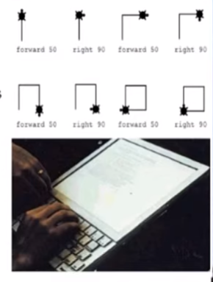
Personal computing
1970s – Papert's LOGO language for simple graphics programming by children
A system is more powerful as it becomes easier to user
Future of computing in small, powerful machines dedicated to the individual
Kay at Xerox PARC – the Dynabook as the ultimate personal computer

Slide 16
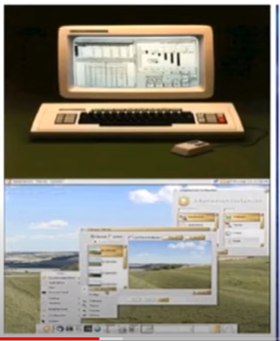
Window systems and the WIMP interface
humans can pursue more than one task at a time
windows used for dialogue partitioning, to “change the topic”
1981 – Xerox Star first commercial windowing system
windows, icons, menus and pointers now familiar interaction mechanisms

Slide 17
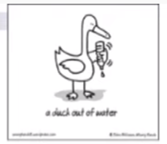
Metaphor
relating computing to other real-world activity is effective teaching technique
  LOGO's turtle dragging its tail
  file management on an office desktop
  word processing as typing
  financial analysis on spreadsheets
  virtual reality – user inside the metaphor
Problems
  some tasks do not fit into a given metaphor
  cultural bias

Slide 18
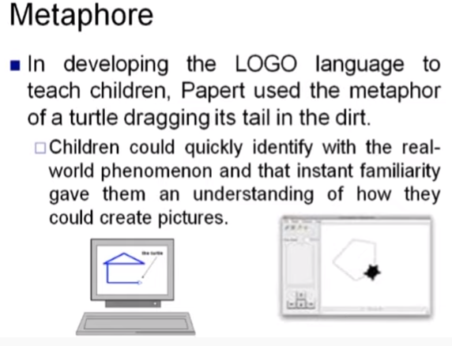


Slide 19
Direct manipulation
1982 – Shneiderman describes appeal of graphically-based interaction
  visibility of objects
  incremental action and rapid feedback
  reversibility encourages exploration
  syntactic correctness of all actions
  replace language with action
1984 – Apple Macintosh
the model-world metaphor
What You See Is What You Get (WYSIWYG)

Slide 20
Language versus Action
actions do not always speak louder than words!
DM – interface replaces underlying system
language paradigm
interface as mediator
interface acts as intelligent agent
programming by example is both action and language

Slide 21
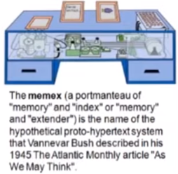
Hypertext
1945 – Vannevar Bush and the
memex
key to success in managing explosion of information
mid 1960s – Nelson describes hypertext as non-linear browsing structure
hypermedia and multimedia
Nelson's Xanadu project still a dream today

Slide 22
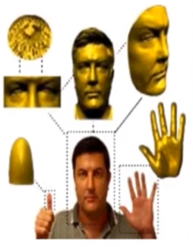
Multimodality
a mode is a human communication channel
emphasis on simultaneous use of multiple channels for input and output

Slide 23
Computer Supported Cooperative Work (CSCW)
CSCW removes bias of single user / single computer system
Can no longer neglect the social aspects
Electronic mail is most prominent success

Slide 24
The World Wide Web
Hypertext, as originally realized, was a closed system
Simple, universal protocols (e.g. HTTP) and mark-up languages (e.g. HTML) made publishing and accessing easy
Critical mass of users lead to a complete transformation of our information economy.

Slide 25
Agent-based Interfaces
Original interfaces
  Commands given to computer
  Language-based
Direct Manipulation/WIMP
  Commands performed on “world” representation
  Action based
Agents - return to language by instilling proactivity and “intelligence” in command processor
  Avatars, natural language processing

Slide 26
Ubiquitous Computing
“The most profound technologies are those that disappear.”
Mark Weiser, 1991
Late 1980’s: computer was very apparent
How to make it disappear?
  Shrink and embed/distribute it in the physical world
  Design interactions that don’t demand our intention

Slide 27
Sensor-based and Context-aware Interaction
Humans are good at recognizing the “context” of a situation and reacting appropriately
Automatically sensing physical phenomena (e.g., light, temp, location, identity) becoming easier
How can we go from sensed physical measures to interactions that behave as if made “aware” of the surroundings?

